Slide 1


Titolo presentazione sottotitolo
A Clinical Validation Tool for Children
Serious Games
Milano, XX mese 20XX

Slide 2
Table of contents
Starting point: Google-Playstore.csv
Filtering Potential “Serious Game”
Filtering out Not Games or Renamed Apps
Enriching the Dataset with Descriptions and Reviews
Keywords Extraction with Natural Language Processing (NLP)
Benchmark For Game Selection
Benchmark Results
Build Dataset with Pubmed Papers
Reliability of Pubmed papers
Threshold for Clinical Validation
Similarity Function for Not Validated Games
Benchmark for Game Validation
Benchmark Results
Dashboard

Slide 3


PROJECT PURPOSE
Nowadays children are increasingly involved in using mobile games
We developed an informatic tool to validate serious games from a clinical point of view found on

Slide 4

Starting point: Google-Playstore.csv
We chose a Google-PlayStore database provided by
Kaggle to import it in our code as first source
Very detailed database containing several features
Highly compatible with the
google-play-scraper library
Back

Slide 5


Filtering Potential “Serious Game”
Our purpose is to find all those applications that can be potentially evaluated as “serious games”
According to the solution we implemented, we based our filters on:
Educational Category selection
Rating threshold
Minimum Rating Count
Back

Slide 6



Filtering out Apps
Check the
category
Renamed
or deleted Drop!
Google Play Scraper
Missing attributes
Not games Drop!
Google Play Scraper
Back

Slide 7



Enriching the Dataset with Descriptions and Reviews
Import
missing
attributes
Extract other important
parameters
Number of Reviews Add!
Google Play Scraper
Conjunction with rating counts
Game Description Add!
Google Play Scraper
Back

Slide 8




Keywords Extraction with Natural Language Processing (NLP)
Classify the filtered games according to their
specific Learning Category and Age Range
Parameters not found neither in Kaggle dataset
nor with Google-Play-Scraper
We build a set of keywords related to different 'Learning category' and 'Age range'. Thus, the 'Learning category' and 'Age range' are assigned based on presence of the keywords found in the Description
Back

Slide 9
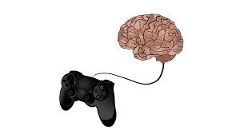






Benchmark For Game Selection
40 Serious Games
40 Non-Serious Games
40 Random Games
120 Application
Benchmark idea: verify that our algorithm has
selected all the serious games and filtered out
the not serious ones and the random apps
Back

Slide 10




Benchmark Results
EVALUATION
Relative Accuracy
85%
Accuracy
92.5%
Sensitivity
77.5%
Specificity
100%
Distinguish a serious game from a non-serious one, or any other application
Recognize a
serious game
Recognize a
non-serious
game
Measures the ability to focus on serious games
Back

Slide 11
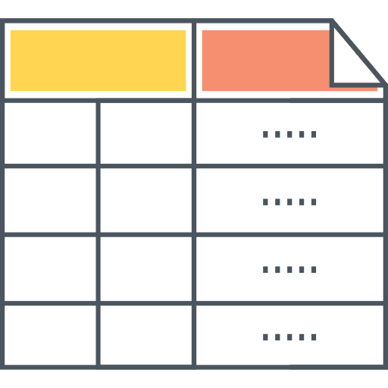

Build Dataset with Pubmed Papers
App
name
Learning
category
Associated papers from PubMed
PubMed is used to retrieve the papers, that the algorithm will use to validate the apps.
Back

Slide 12
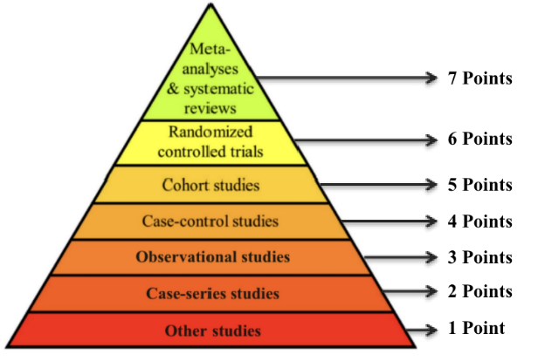




Reliability of Pubmed papers
Provide a Validation Score based on type ,and so reliability, of associated papers on Pubmed.
Implement a function that rewards the relevance of keywords associated to clinical studies with higher reliability in the different sections of the papers.
Back

Slide 13
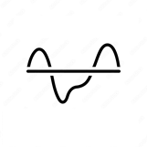



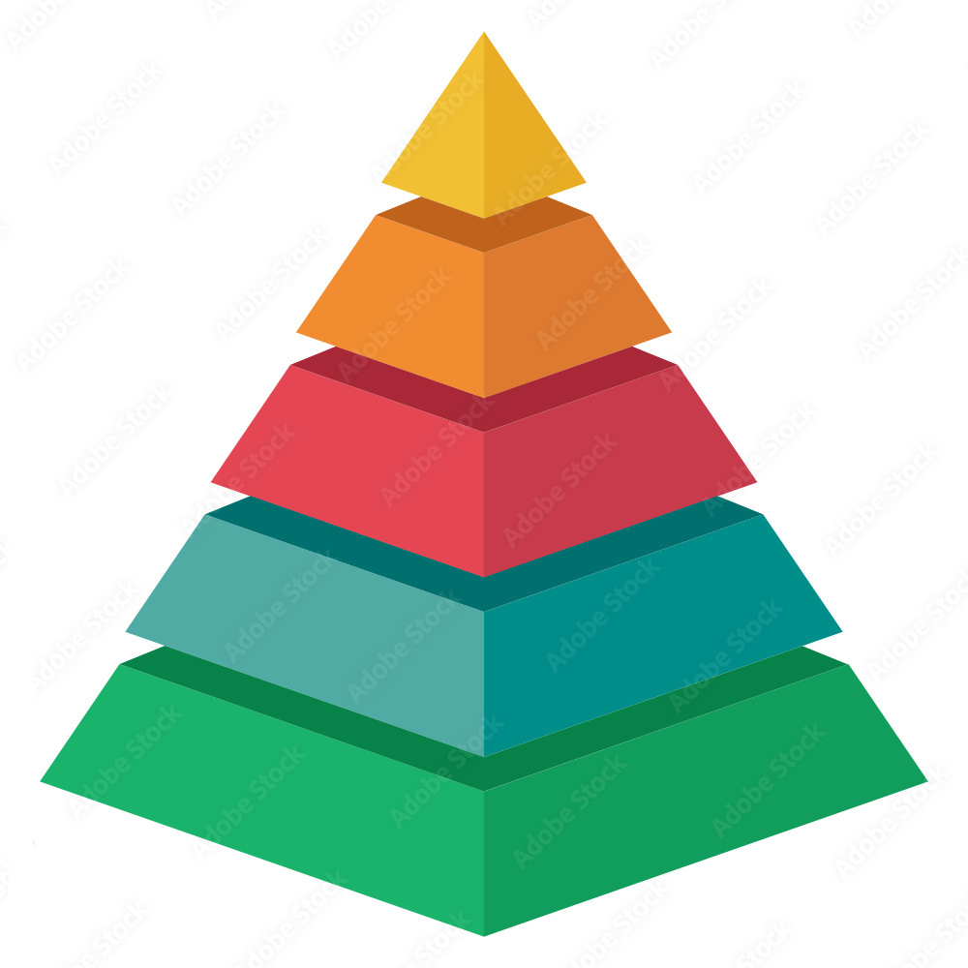

Threshold for Clinical Validation
Not Validated Games
Validated Games
We considered the presence of a keyword related to an observational study as a threshold for validation
Back

Slide 14


Similarity function for Not Validated Games
Let the user consult validated games of the same Learning Category of the non-validated ones
Validated Games
Learning Category
Not Validated Games
Back

Slide 15



Benchmark for Game Validation
30 serious validated games
5 serious non-validated games
Benchmark idea: Compare the clinical validation
of a serious game found by our algorithm
and the one found by a person
Back

Slide 16



Benchmark Results
EVALUATION
Accuracy
92.5%
Sensitivity
77.5%
Specificity
100%
Distinguish between a validated serious game and not validated serious one
Recognize a validated serious game
Recognize a not validated serious game
Back

Slide 17


Benchmark for study type recognition
We selected 10 papers per study type
Benchmark idea: Compare validation score found by our algorithm
to the one found by a person
Back

Slide 18

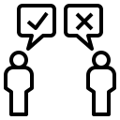
Benchmark Results
ACCURACY
Percentage of correctly classified study type: 43.2%
M.A.E.
Mean scores’ differences: 26.8%

Slide 19





Dashboard
To display all mentioned information
Available serious games per Learning Category and Age Range?
Level of Clinical Validation associated a given serious game?
Level of validation of a given paper according to its study type?
Similar validated application for a not validated game?

Slide 20
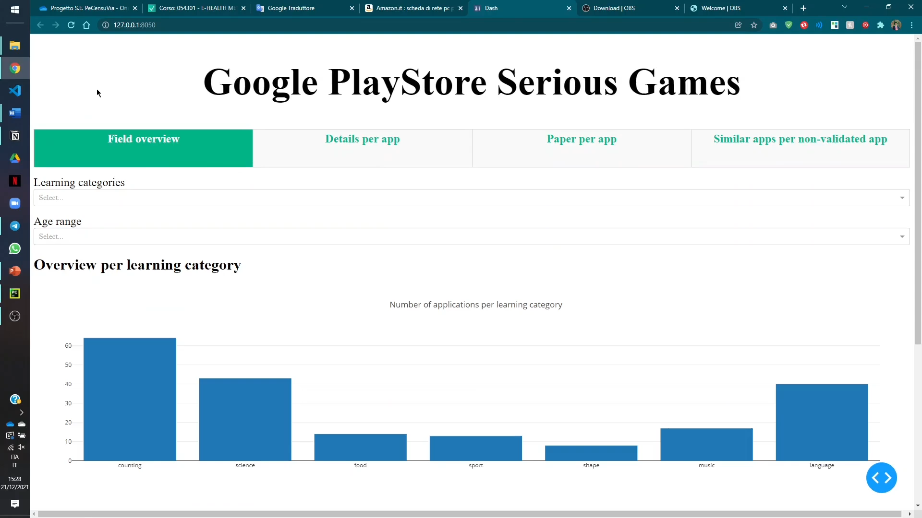
Dashboard (Presentation)

